Slide 1

Indian Society for technical education
Getting started with GITHUB

Slide 2
Overview
What is version control?
Git and GitHub
Important Terms
Git Commands
Workflow
Git Branching
Pull request
Merge conflicts and open source programing

Slide 3
What is version control?
A system that keeps record your changes.
Allows for collaborative development.
Allows us to know who made what changes and when.
Allow us to revert any changes and go back to previous state.
Its important to get accustomed to version control systems as it used for every modern software team's professional practices.

Slide 4
Git and Github (Are they really different?)
Git is the most widely used modern version control system.
It’s a command line tool
It can revert file or whole project to earlier state.
Compare changes over time.
Control modifications by the collaborators with the permission of admin.

Slide 5
On other hand…
Github is a repository hosting service for git.
Github is web based graphical interface that works on top of git.
It can be treated as social platform for sharing your projects and work.
It is used to host open source project for free.

Slide 6
Some important terms
Directory: Refers to folder.
Terminal/CLI: An interface for text commands.
Repository: Collection of all files and history of those files.
Cd: Used to change or switch folders/directories.

Slide 7
Github commands
Clone: Used to copy the repository from remote server.
Add: It updates the current content of the working tree to the staging area
Commit: It record changes to the local repository.
Push: Used to add local changes to remote repository
Pull: Used to download commits that don’t exist on locally from remote repository.

Slide 8
Before we begin with coding make sure you have following installed in your system
Any text editor (vs code preferable)
Install Git with git bash
For installing git: go to gitforwindows.org<<download git<<start the installer<<follow next and finish prompts.
Open the command prompt or git bash or vs code terminal for CLI.
Sign up on github

Slide 9
Run the following commands to configure your Git username and email using the following commands. These details will be associated with any commits that you create:
$ git config --global user.name “<username>" $ git config --global user.email “<username>"

Slide 10
Lets Code!

Slide 11
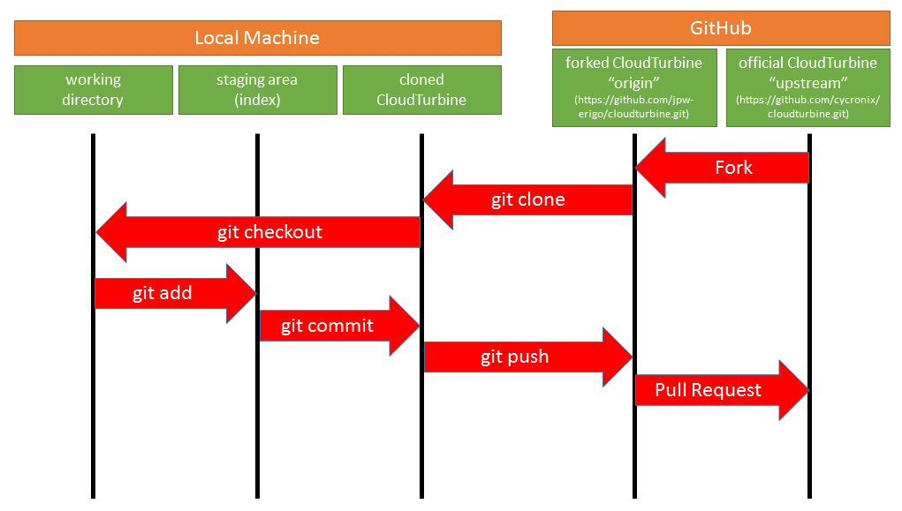
Workflow
Forked repo “origin”
Original repository

Slide 12
Git Branching
We saw earlier that initially we were committing to master branch which is our main or default branch.
One of the most important functions of Git is the control of branches of development that help us have multiple versions of an application organized.
Create a branch in your project, for an environment where you can try out new ideas.

Slide 13

Source: https://www.nobledesktop.com/image/blog/git-branches-merge.png

Slide 14
Advantages of Branching
Branching makes it possible to develop new features for our application without hindering the development in the main branch.
With Git branches it is possible to create different development branches that can converge in the same repository.
Changes we make on any branch does not affect master branch unleass pull request is accepted.

Slide 15
Lets code!

Slide 16
Pull Requests
Pull Requests are the heart of collaboration on GitHub.
When you open a pull request, you’re proposing your changes and requesting that someone review and pull in your contribution and merge them into their branch.
Pull requests show differences of the content from both branches.
Pull request also initiates discussion about your commits or changes made to code.

Slide 17
Some basics about Merge conflicts and open source programming

Slide 18
Thank You!

Slide 19

Indian Society For Technical Education
istevit.in
instagram.com/iste_vit_vellore
facebook.com/ISTE.VIT
linkedin.com/company/indian-society-for-technical-education
github.com/ISTE-VIT
Speaker
Aditya Jain
github.com/jaditya8109
www.linkedin.com/in/aditya-jain-479b96157/

